Slide 1
EE 458 Introduction to C and Code Composer Studio
Ishaan Bhimani
EE458 Winter 2022

Slide 2
Agenda:
Intro to C for EE458 (not comprehensive)
Syntax
Variables and defines
Types (ints, floats)
Header files
Functions
Variable scoping
Loops/conditionals
Intro to CCS
Standard CCS Code walkthrough
Register access
Interrupts
Watch Window
Debug

Slide 3
Syntax:
Very similar to Java
Assume students have used Python. Differences below:
Semicolons required
Type required when declaring/initializing
Comments denoted with “//” or “/* ….. */”
Whitespace does not matter, brackets do

Slide 4
Variables
Variable must be declared before definition. Can be done simultaneously with initialization.
Example:
int j; // declare (value of j is garbage)
j = 1; // define (change value to 1)
int k = 2; // initialize k to value of 1

Slide 5
Types
In EE458 we will use mostly integers and floats.
Integers (ints) can be unsigned or signed, and do not have decimal (will round down)
Ints have different sizes (in bits). Make sure we know the correct size by using standard sizes:
Example: uint16_t is a 16 bit (2 byte) unsigned integer
Important to understand sizes to make sure the max/min values of the data type not exceeded (see next slides for limits)
For EE458 you will likely not see this problem

Slide 6
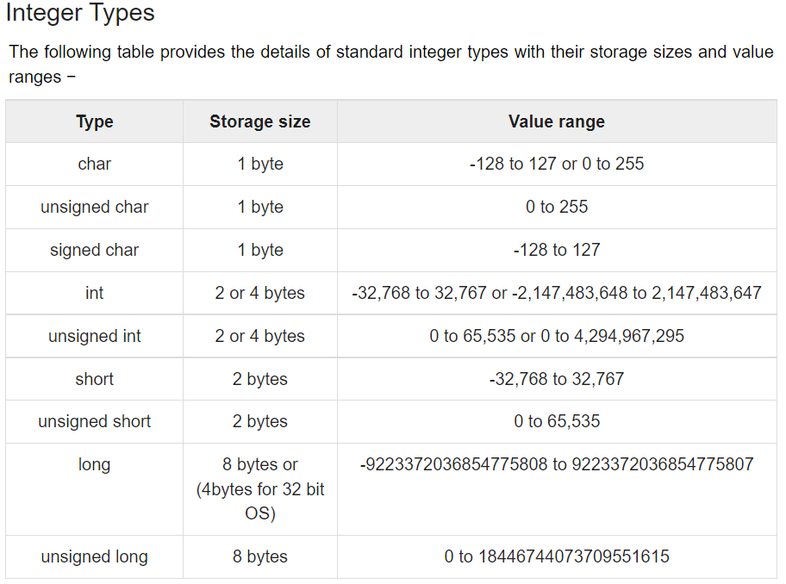

Slide 7
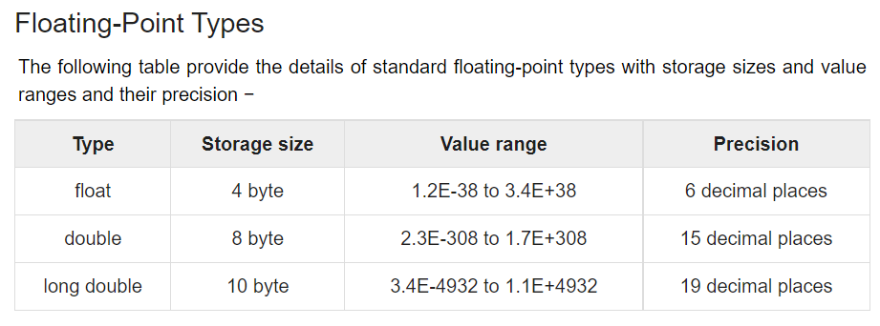

Slide 8
Data Structures
Arrays:
Of any data type
0 indexed
Initialized to garbage!
type array_name [array_size];
Structs (aside)
Kind of like objects, but without functions
struct StructTag {
type field_1;
…
type field_n;
} structName;
Access:
structName.field_1 = value;

Slide 9
Define statements
NOT a variable, just a value
Equivalent to find and replace at compile time
Example:
#define pi 3.14
This will replace all standalone “pi” words with “3.14” at compile time. Can now treat “pi” as a constant.
Parentheses important if #define statement is complex, otherwise weird bugs can occure

Slide 10
Header Files
Basically like “import” in Python
C has standard libraries, included as standard headers
Can also make custom header files
#include <standard_header.h>
#include “custom_header.h”

Slide 11
Functions:
Functions must either be defined before use, or declared at the top of the file and defined elsewhere (2nd option best practice);
Params passed by VALUE
Function declaration:
ret_type function_name(params);
Function definition:
ret_type function_name(params) {
return return_val; //return_val is of type ret_type
}

Slide 12
Variable Scoping
Similar to Python
Global variables accessible anywhere
Local variables accessible only within the function.
Functions are pass by value:
int i = 1;
int j = increment_by_10(i); // increments arg by 10
printf(“%d \n”, i); //prints 1
printf(“%d \n”, j); //prints 11

Slide 13
Loops
Similar to Python
while (condition) {
// do stuff
}
int i;
for(i = 0; i < 10; i++) {
// do stuff for 10 iterations
}

Slide 14
Code Sample Walkthrough
Code available on Canvas

Slide 15
Code Composer Studio
Texas Instrument IDE for their embedded platforms
We are using a C2000 F280049C (real-time DSP).
Things to note about CCS:
Sample code available, we will start from a base sample
Register access available, we will modify values at the register level
Note: registers in embedded systems often have special functions. Register holds data for read and write. Based on what the register holds, the microcontroller may behave differently.
No printing to console (there is no console!). Instead use the watch window and debug
We will use an interrupt (code in the interrupt service routine is called every time the interrupt event occurs, in our case, on a Timer. Basically, this means this code section runs every periodically without us calling it!)

Slide 16
CCS Walkthrough of Sample Code
Can download using instructions from Canvas

